Slide 1
High-Frequency Trading Module 4 – Advanced modeling
Slides to accompany High-Frequency Trading: A Practical Guide to Algorithmic Strategies and Trading Systems, 2nd edition, by Irene Aldridge

Slide 2
Outline
Project Discussion
Modeling LOB dynamics
Detecting market manipulation
Detecting one-sided liquidity
Detecting abnormalities in market data
Detecting impending market crashes

Slide 3
2.1. Modeling Limit Order Books

Slide 4
2.2 Sample dynamics
A large market sell order
sweeps the bids in the book,
realizes lower aggregate price,
changes the best bid
Best bid
Best ask = best offer
Bid-ask spread
price
price
New best bid
A new limit buy order arrives at a price higher than the best bid but lower than the best ask
A new limit buy order arrives at a price lower than the best bid
New best bid
Best ask = best offer
price
Bid-ask spread
price

Slide 5
2.2. LOB = Queuing System!

Slide 6




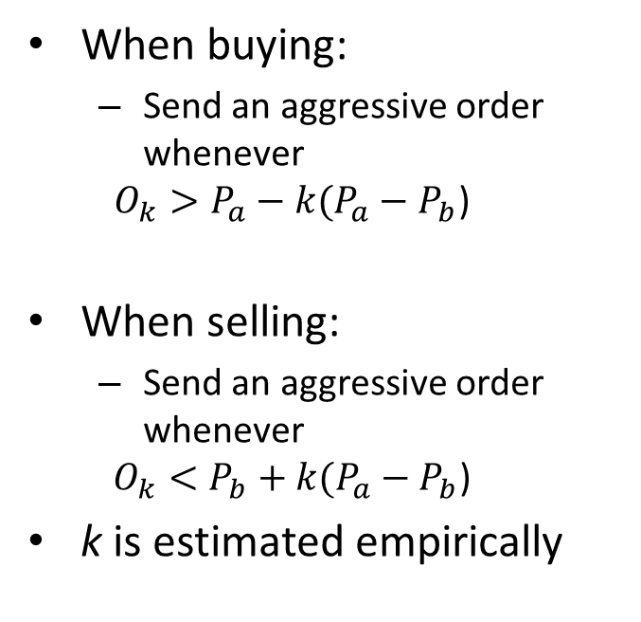
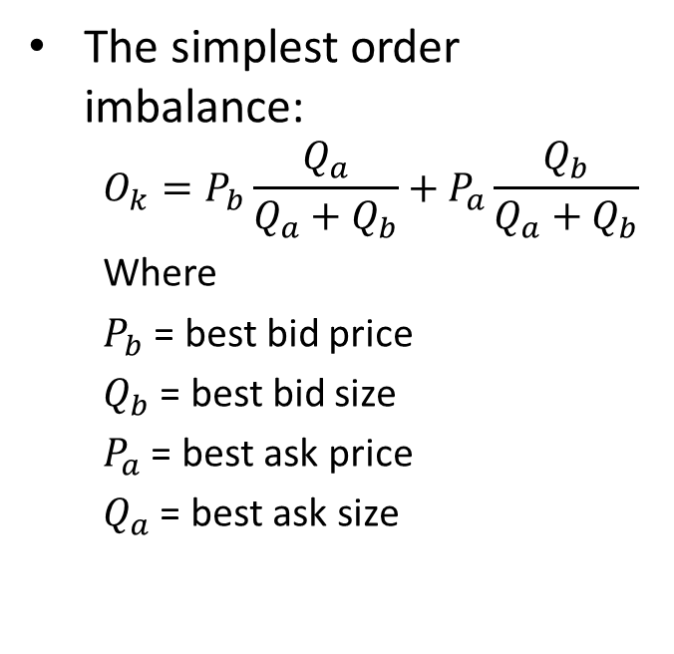
2.2. LOB Queues
Order cancellations are disallowed:
Order cancellations are allowed (vanilla matching):
Top-of-the-book cancellations not allowed, but okay elsewhere
…
$$s_{n}$$
$$s_{2}$$
$$s_{1}$$
…
$$s_{k}$$
$$s_{2}$$
$$s_{1}$$
…
$$s_{k}$$
$$s_{2}$$
$$s_{1}$$

Slide 7
2.2. Related literature
Cont, Stoikov and Talreja (OR, 2010)
Cont and Kukanov (2012)
Hasbrouck (2012, 2013)
Easley, Lopez de Prado, and O’Hara (2011, 2012)
Vanden Eijnden (2010, 2011, 2012)
Many others

Slide 8
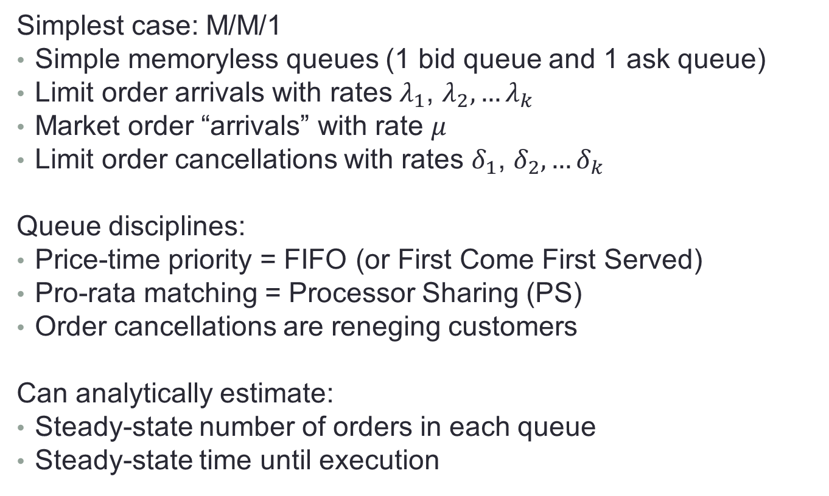
2.2. Modeling queues
Simplest case: M/M/1
Simple memoryless queues (1 bid queue and 1 ask queue)
Limit order arrivals with rates $λ_{1}$, $λ_{2}, …λ_{k}$
Market order “arrivals” with rate $μ$
Limit order cancellations with rates $δ_{1}$, $δ_{2}, …δ_{k}$
Queue disciplines:
Price-time priority = FIFO (or First Come First Served)
Pro-rata matching = Processor Sharing (PS)
Order cancellations are reneging customers
Can analytically estimate:
Steady-state number of orders in each queue
Steady-state time until execution

Slide 9

2.2. Modeling Results (Aldridge, 2013)
Any priority (FIFO or PS – same steady-state probabilities discussed here), no cancellations
Assumptions: steady-state, exponentially-distributed limit and market order arrivals, where limit order cancellations are not allowed (order cancellation rate $δ=0$)
$P\left(I_{∞,k}=z\right)=\left(\left(1−ρ_{1}\right)\left(1−ρ_{2}\right)…\left(1−ρ_{k}\right)\right){ρ_{k}}^{z}$
where $ρ_{k}≡\frac{λ_{k}}{μ}$ is traffic intensity in the kth queue, and $λ_{k}$ is the arrival rate of limit orders into queue k.

Slide 10
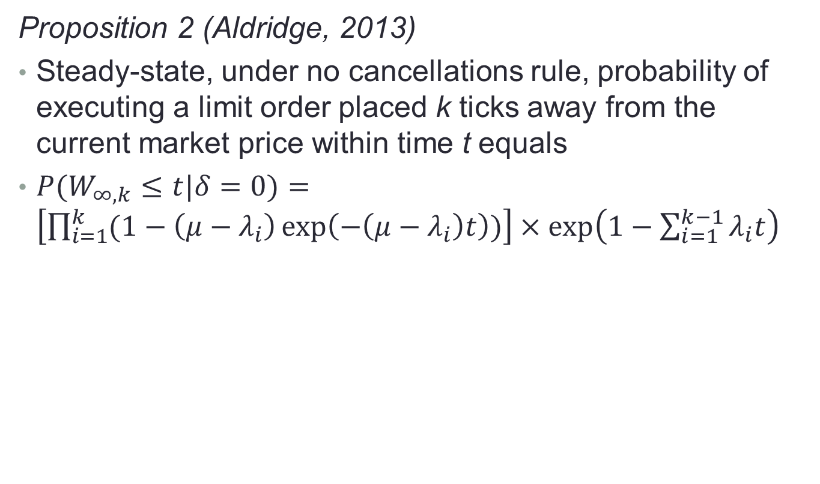
2.2. Time to execution in queue k
Proposition 2 (Aldridge, 2013)
Steady-state, under no cancellations rule, probability of executing a limit order placed k ticks away from the current market price within time t equals
${P(W}_{∞,k}≤t|δ=0)=\left[\prod_{i=1}^{k}{(1−\left(μ−λ_{i}\right)\exp\left(−\left(μ−λ_{i}\right)t\right))}\right]×\exp\left(1−\sum_{i=1}^{k−1}{λ_{i}t}\right)$

Slide 11
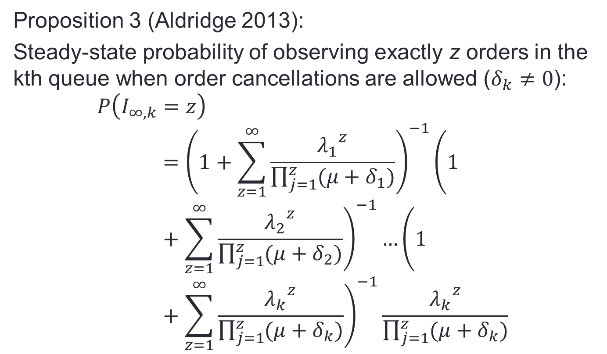
2.2. Modeling results 2
Proposition 3 (Aldridge 2013):
Steady-state probability of observing exactly z orders in the kth queue when order cancellations are allowed ($δ_{k}≠0$):
$$P\left(I_{∞,k}=z\right)={\left(1+\sum_{z=1}^{∞}{\frac{{λ_{1}}^{z}}{\prod_{j=1}^{z}{(μ+δ_{1})}}}\right)}^{−1}{\left(1+\sum_{z=1}^{∞}{\frac{{λ_{2}}^{z}}{\prod_{j=1}^{z}{(μ+δ_{2})}}}\right)}^{−1}…{\left(1+\sum_{z=1}^{∞}{\frac{{λ_{k}}^{z}}{\prod_{j=1}^{z}{(μ+δ_{k})}}}\right)}^{−1}\frac{{λ_{k}}^{z}}{\prod_{j=1}^{z}{(μ+δ_{k})}}$$

Slide 12

2.2. Modeling results 2
Proposition 4: Wait time to execution when cancellations are allowed
${P(W}_{∞,k}≤t)=\left[\prod_{i=1}^{k}{(1−\left(μ+δ_{i}−λ_{i}\right)\exp\left(−\left(μ+δ_{i}−λ_{i}\right)t\right))}\right]×\exp\left(1−\sum_{i=1}^{k−1}{λ_{i}t}\right)$

Slide 13

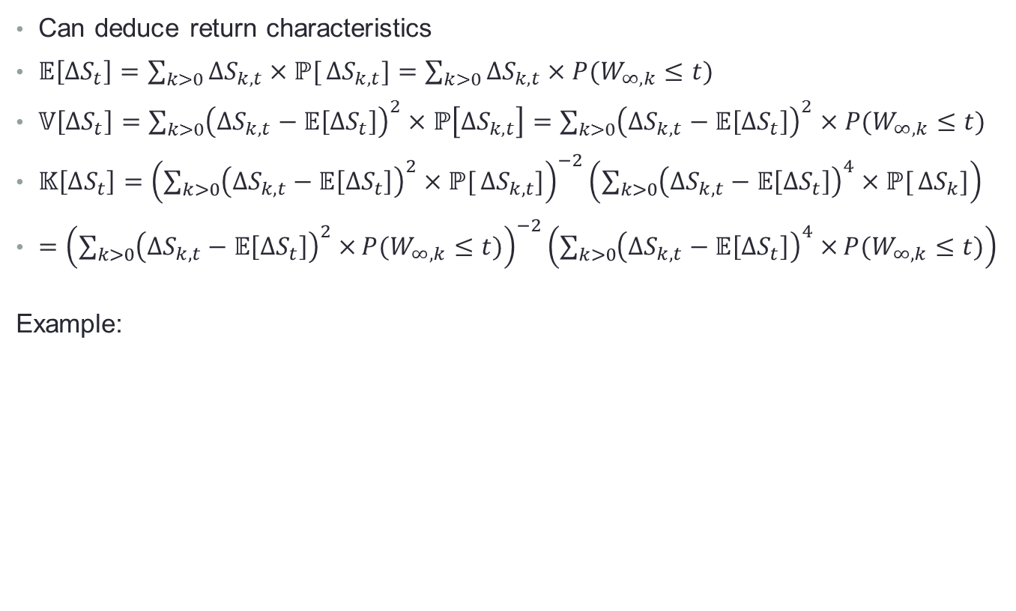
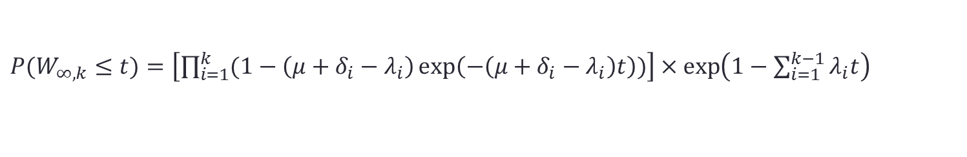

2.2. So what?
Can deduce return characteristics
$𝔼\left[∆S_{t}\right]=\sum_{k>0}{∆S_{k,t}×ℙ[}∆S_{k,t}]=\sum_{k>0}{∆S_{k,t}×{P(W}_{∞,k}≤t)}$
$𝕍\left[∆S_{t}\right]=\sum_{k>0}{{\left(∆S_{k,t}−𝔼\left[∆S_{t}\right]\right)}^{2}×ℙ\left[∆S_{k,t}\right]}=\sum_{k>0}{{\left(∆S_{k,t}−𝔼\left[∆S_{t}\right]\right)}^{2}×{P(W}_{∞,k}≤t)}$
$𝕂\left[∆S_{t}\right]={\left(\sum_{k>0}{{\left(∆S_{k,t}−𝔼\left[∆S_{t}\right]\right)}^{2}×ℙ[}∆S_{k,t}]\right)}^{−2}\left(\sum_{k>0}{{\left(∆S_{k,t}−𝔼\left[∆S_{t}\right]\right)}^{4}×ℙ[}∆S_{k}]\right)$
$={\left(\sum_{k>0}{{\left(∆S_{k,t}−𝔼\left[∆S_{t}\right]\right)}^{2}×}{P(W}_{∞,k}≤t)\right)}^{−2}\left(\sum_{k>0}{{\left(∆S_{k,t}−𝔼\left[∆S_{t}\right]\right)}^{4}×}{P(W}_{∞,k}≤t)\right)$
Example:
$$∆S_{3,t}$$
$${P(W}_{∞,3}≤t)$$
${P(W}_{∞,k}≤t)=\left[\prod_{i=1}^{k}{(1−\left(μ+δ_{i}−λ_{i}\right)\exp\left(−\left(μ+δ_{i}−λ_{i}\right)t\right))}\right]×\exp\left(1−\sum_{i=1}^{k−1}{λ_{i}t}\right)$

Slide 14
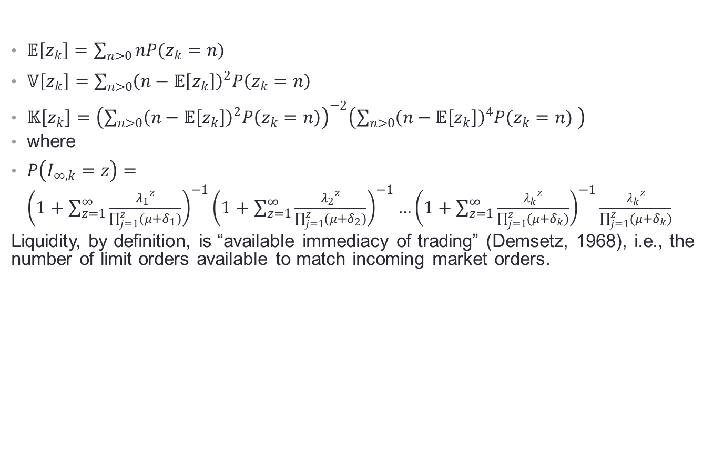
2.2. And liquidity characteristics
$𝔼\left[z_{k}\right]=\sum_{n>0}{nP(z_{k}=n) }$
$𝕍\left[z_{k}\right]=\sum_{n>0}{{\left(n−𝔼\left[z_{k}\right]\right)}^{2}P\left(z_{k}=n\right)}$
$𝕂\left[z_{k}\right]={\left(\sum_{n>0}{{\left(n−𝔼\left[z_{k}\right]\right)}^{2}P\left(z_{k}=n\right)}\right)}^{−2}\left(\sum_{n>0}{{\left(n−𝔼\left[z_{k}\right]\right)}^{4}P(z_{k}=n) }\right)$
where
$P\left(I_{∞,k}=z\right)={\left(1+\sum_{z=1}^{∞}{\frac{{λ_{1}}^{z}}{\prod_{j=1}^{z}{(μ+δ_{1})}}}\right)}^{−1}{\left(1+\sum_{z=1}^{∞}{\frac{{λ_{2}}^{z}}{\prod_{j=1}^{z}{(μ+δ_{2})}}}\right)}^{−1}…{\left(1+\sum_{z=1}^{∞}{\frac{{λ_{k}}^{z}}{\prod_{j=1}^{z}{(μ+δ_{k})}}}\right)}^{−1}\frac{{λ_{k}}^{z}}{\prod_{j=1}^{z}{(μ+δ_{k})}}$
Liquidity, by definition, is “available immediacy of trading” (Demsetz, 1968), i.e., the number of limit orders available to match incoming market orders.

Slide 15
2.2. Key Conclusions
Different order matching principles result in different market characteristics:
Characteristic | Vanilla Price-Time Priority | No-Cancel-Range Either Priority | Vanila Pro-Rata Matching
Market volatility | High | Low | Medium
Fat tails of returns | High | Low | Medium
Market liquidity | High | Low | Medium
Ability to detect spoofing market manipulation *covered next | Low | High | High

Slide 16
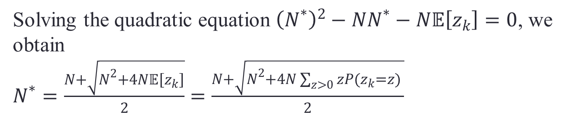
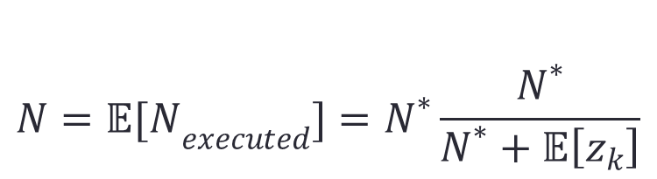
2.3 Optimal Limit Order Size in Pro-Rata
$$N={𝔼[N}_{executed}]=N^{∗}\frac{N^{∗}}{N^{∗}+𝔼\left[z_{k}\right]}$$
Solving the quadratic equation ${\left(N^{∗}\right)}^{2}−NN^{∗}−N𝔼\left[z_{k}\right]=0$, we obtain
$N^{∗}=\frac{N+\sqrt{N^{2}+4N𝔼\left[z_{k}\right]}}{2}=\frac{N+\sqrt{N^{2}+4N\sum_{z>0}{zP(z_{k}=z) }}}{2}$

Slide 17


2.4 Estimating Parameters
Did a trade print just go through?
Was the trade print closer to BB than to BO?
The trade was initiated by a market sell:
$${μ_{t}}^{s}={μ_{t}}^{s}+trade size$$
Yes
Yes
No
No
Go to next page
Was the trade print closer to BO than to BB?
The trade was initiated by a market buy:
$${μ_{t}}^{b}={μ_{t}}^{b}+trade size$$
Yes
No
Use tick rule
(per Lee Ready, 1991)
Figure 10. Diagram of the logic for determining whether a trade print was initiated by a market buy or a market sell

Slide 18


2.4 Estimating Parameters
Did a trade print just go through?
Go to previous page
Yes
No
Did the best bid price change?
Did the best bid price or size increase?
Yes
Yes
New bb arrived
$${λ_{1,t}}^{b}={λ_{1,t}}^{b}+Δ|bid size|$$
No
No
Repeat same for ask (offer) side
Did the best bid price or size decrease?
Yes
New cancel bid arrived
$${δ_{1,t}}^{b}={δ_{1,t}}^{b}+|Δbid size|$$

Slide 19
2.4 Estimating Parameters
Print Type BB Size BO Size Trade Price Trade Size Print Classification
Quote 1.08 50 1.10 100
Trade 1.08 30 Market sell 30
Quote 1.08 20 1.10 100
Trade 1.08 20 Market sell 20
Trade 1.07 100 Market sell 100
Quote 1.07 50 1.09 80 Limit sell 80
Quote 1.08 100 1.09 80 Limit buy 50
Quote 1.08 200 1.09 80 Limit buy 100
Quote 1.08 200 1.09 50 Cancel sell 30
Trade 1.09 50 Market buy 50

Slide 20
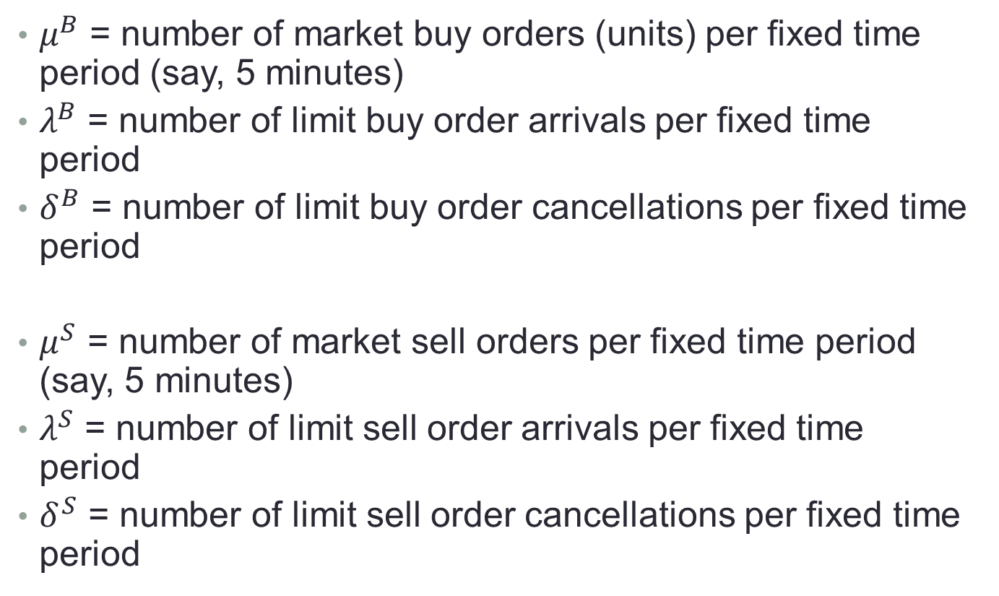
2.4 Estimating Parameters – Top of the book
$μ^{B}$ = number of market buy orders (units) per fixed time period (say, 5 minutes)
$λ^{B}$ = number of limit buy order arrivals per fixed time period
$δ^{B}$ = number of limit buy order cancellations per fixed time period
$μ^{S}$ = number of market sell orders per fixed time period (say, 5 minutes)
$λ^{S}$ = number of limit sell order arrivals per fixed time period
$δ^{S}$ = number of limit sell order cancellations per fixed time period

Slide 21

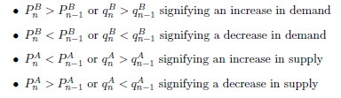
2.5 Using events to predict ST returns
Events:
Limit order arrivals
Market order arrivals
Limit order cancellations
Cont, Kukanov, Stoikov (2011)
Over short-term periods, price changes are driven by order-flow imbalance, OFI:

Slide 22
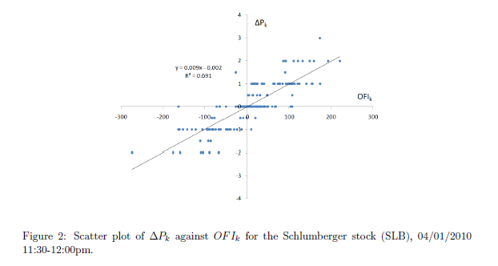
2.5 Using events to predict ST returns
Cont, Kukanov, Stoikov (2011)

Slide 23
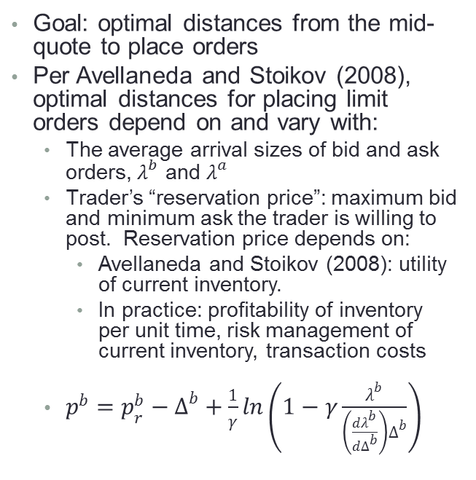
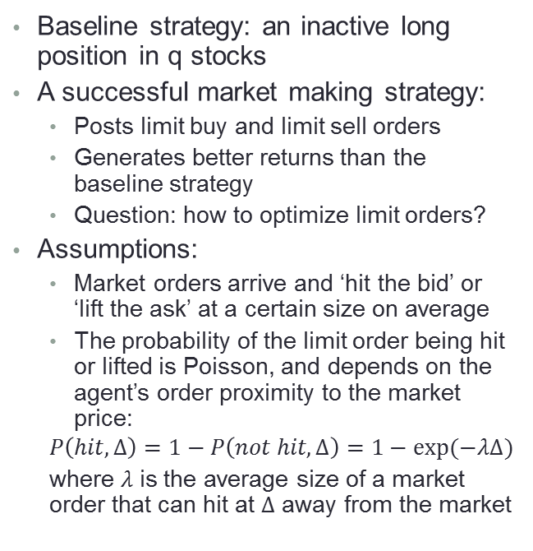
2.6 Inventory-based Market Making
An inventory-based market-making model
Avellaneda and Stoikov (2008)
Baseline strategy: an inactive long position in q stocks
A successful market making strategy:
Posts limit buy and limit sell orders
Generates better returns than the baseline strategy
Question: how to optimize limit orders?
Assumptions:
Market orders arrive and ‘hit the bid’ or ‘lift the ask’ at a certain size on average
The probability of the limit order being hit or lifted is Poisson, and depends on the agent’s order proximity to the market price:
$$P\left(hit, ∆\right)=1−P\left(not hit, ∆\right)=1−exp(−λΔ)$$
where $λ$ is the average size of a market order that can hit at $Δ$ away from the market
Goal: optimal distances from the mid-quote to place orders
Per Avellaneda and Stoikov (2008), optimal distances for placing limit orders depend on and vary with:
The average arrival sizes of bid and ask orders, $λ^{b}$ and $λ^{a}$
Trader’s “reservation price”: maximum bid and minimum ask the trader is willing to post. Reservation price depends on:
Avellaneda and Stoikov (2008): utility of current inventory.
In practice: profitability of inventory per unit time, risk management of current inventory, transaction costs
$p^{b}=p_{r}^{b}−Δ^{b}+\frac{1}{γ}ln\left(1−γ\frac{λ^{b}}{\left(\frac{dλ^{b}}{dΔ^{b}}\right)Δ^{b}}\right)$

Slide 24
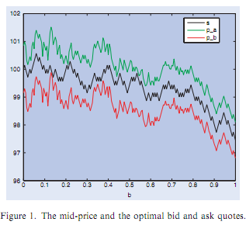
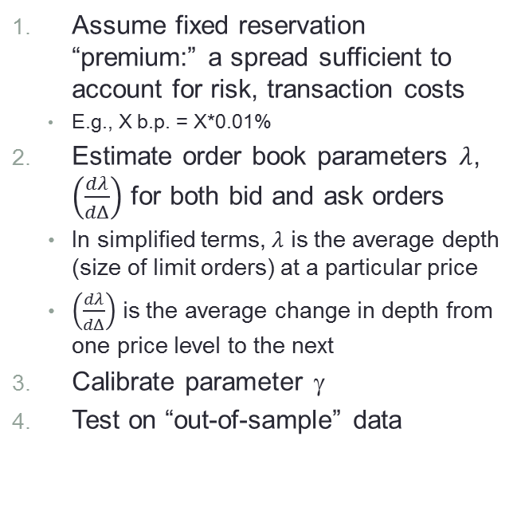
2.6 Inventory-based Market-Making
Generated quotes
Practical Implementation Steps
Source: Avellaneda & Stoikov (2008)
Assume fixed reservation “premium:” a spread sufficient to account for risk, transaction costs
E.g., X b.p. = X*0.01%
Estimate order book parameters $λ$, $\left(\frac{dλ}{dΔ}\right)$ for both bid and ask orders
In simplified terms, $λ$ is the average depth (size of limit orders) at a particular price
$\left(\frac{dλ}{dΔ}\right)$ is the average change in depth from one price level to the next
Calibrate parameter γ
Test on “out-of-sample” data

Slide 25
Outline
Short-term forecasting
Modeling LOB Dynamics
Detecting market manipulation
Detecting one-sided liquidity
Detecting abnormalities in market data
Detecting impending market crashes

Slide 26
3. Market manipulation
Pump and dump (aka bear raid)
Spoofing

Slide 27
3.1. How to detect adverse conditions
High-frequency “pump-and-dump”
AKA “bear raid”
A specific case of potential HFT manipulation
An Pump-and-dump (PnD) strategy would
Pump: place buy (sell) orders in a rapid sequence
Create an impression of high (low) permanent impact, artificially inflating (deflating) prices
Dump: sell (buy) security once the price has substantially departed from fundamentals
HFT “pump-and-dump” (PnD), an illustration
PnD
gain
time
PnD
buy
PnD
buy
PnD
sell
PnD
sell

Slide 28
3.1. How to detect adverse conditions
Pump-and-dump feasibility
Pump-and-dump (bear raids) are only feasible under one specific market condition
Permanent market is NOT symmetric between buys and sells
Gatheral (2009)
Notation:
Trade size:
Market impact:
HFT “bear raid” (BR), an illustration
In the example, BR is profitable because
BR
gain
time
BR
sell
BR
sell
BR
sell
BR
sell

Slide 29
3.1. How to detect adverse conditions
“If ΔΡ(v) > − ΔΡ(−v), we could manipulate the market price by buying then selling
at the same rate and conversely if ΔΡ(v) < − ΔΡ(−v), we could manipulate
the market price by selling then buying at the same rate.”
Gatheral (2009)
HFT “pump-and-dump” (PnD), an illustration
In the example, pump-and-dump is profitable because
PnD
gain
time
PnD
buy
PnD
buy
PnD
sell
PnD
sell

Slide 30
3.1. How to detect adverse conditions
No pump-and-dump condition:
What about temporary impact?
Temporary Impact (power-law decay) is only time-dependent
Has no impact on pump-and-dump feasibility
When market impact is symmetric for buys and sells, pump-and-dump (or a bear raid) is NOT feasible
time
PnD
buy
PnD
buy
PnD
sell
PnD
sell
Testable hypothesis: Is ?

Slide 31
3.1. HFT Impact: case study
Data: Eurobund futures (FGBL)
FGBL is very liquid:
10,000-80,000 trades per day
Distribution of trades per day
Traded on Eurex
All trade ticks 2009-2010
Timestamp
Trade price
Trade size
No quote information
No information on the identity of trade originators
No information on whether the trade was buyer- or seller- originated.

Slide 32
3.1. HFT Impact: case study
Lots of large trades
>20,000 contracts
Median trade size is small
~ just 5 contracts

Slide 33
3.1. HFT Impact: case study
Large trades: size > median (5 contracts)
Following Huberman and Stanzl (2004) and Gatheral (2009): Symmetric market impact eliminates possibility of ‘pump-and-dump
Pump and Dump is NOT feasible in large FGBL futures trades

Slide 34
3.1. HFT Impact: case study
Small trades: size <= median (5 contracts)
Symmetry less clear cut, but the $$ amount gained dissipates after trading costs are taken into account
Pump and Dump is NOT economical in small FGBL futures trades

Slide 35
3.1. HFT Impact: case study
Additional explanatory variables do not change results
Comparison with equities: market impact in FGBL is much smaller than in equities
Trade size dependency and sign hold with same statistical significance even in the presence of other variables
Inter-trade duration results are consistent with those in equities by Dufour and Engle (2000): shorter intertrade durations incur lower market impact
Pre-trade market impact rises with volatility for large trades, decreases with volatility for small trades.
Volatility coefficients are large, may help explain the entire pre-trade market impact
Overall, observed market impact in FGBL futures is much smaller than that documented for equities
Eurex FGBL futures market impact is small, on the order of 0.02% per trade
In equities, the ITG’s Global Trading Cost Review (2010) reported:
The average cost of an equities trade in the U.S. in the first quarter of 2010 was 0.476%,
0.089% was spent on commissions
the remaining 0.387% were due to market impact (the numbers were comparable to those in the E.U., the U.K., and Japan; emerging markets posted higher costs).
Volatility is a key driver of market impact for large trades

Slide 36
3.1. Generalized conditions
Generalized Conditions
References
A price manipulation strategy is a round-trip strategy with strictly negative expected costs
A round trip strategy is an admissible strategy with $X_{0}=0$
Huberman and Stanzl (2004)
$C(X)≥0$ for all admissible strategies X iff $G(|.|)$ can be represented as a Fourier transform of a positive finite Borel measure μ on $ℝ$:
$G\left(\left|x\right|\right)=\int{e^{ixz}μ(dz)}$
Bochner (1932), Reed and Simon (1980)
Huberman, G. and W. Stanzl (2004): Price manipulation and quasi-arbitrage. Econometrica 72, 4, 1247-1275.
Bochner, S. (1932): Vorlesungen uber Fouriersche Integrale. Akademische Verlagsgesellschaft, Leipzig.
Reed, M. and B. Simon (1980): Methods of Modern Mathematical Physics. Vol. I: Functional Analysis. Revised and enlarged edition, San Diego: Academic Press.

Slide 37
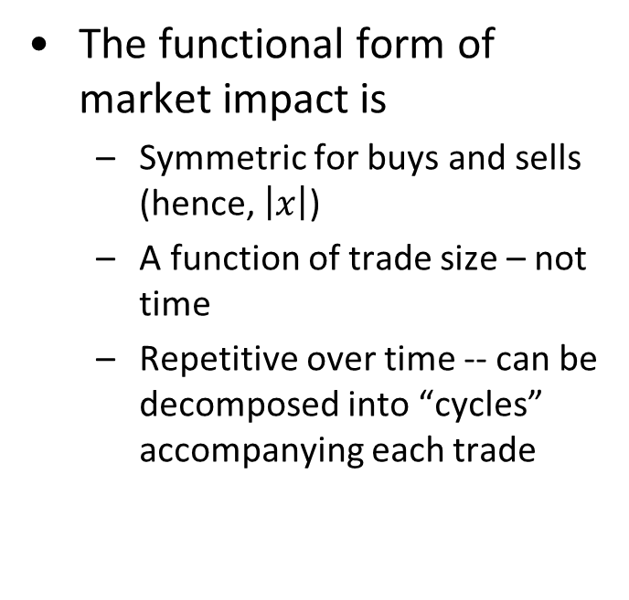
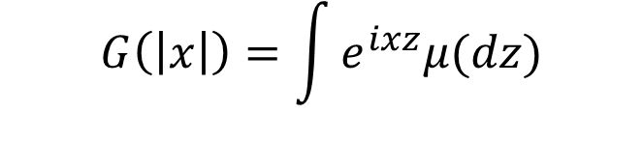
3.1. Interpretation
$$G\left(\left|x\right|\right)=\int{e^{ixz}μ(dz)}$$
The functional form of market impact is
Symmetric for buys and sells (hence, $\left|x\right|$)
A function of trade size – not time
Repetitive over time -- can be decomposed into “cycles” accompanying each trade
The bottom line:
Expected market impact is symmetric and persistent for buys and sells of the same size

Slide 38
3.2. Market manipulation by spoofing
Regulators recognize one HFT-related form of manipulation: spoofing
Spoofing is illegal and has been prosecuted
How does spoofing work?
Traders and algos make short-term inferences from the shape of the limit order book
Spoofers distort the limit order book to mislead others, main point: cause ST market move, but cancel limit orders prior to execution
Stylized example:
Spoof
orders

Slide 39
3.2. Detection is complicated
In price-time priority markets, many broker-dealers earn their living by securing time priority for their clients
But, most of those broker-dealers would place orders on both sides of the market
Still, some brokers may anticipate clients’ demands and place orders on one side only

Slide 40
3.2. Spoofing ability depends on microstructure
Proposition 5 (Aldridge 2013):
Spoofing is most likely in vanilla price-time priority markets
Spoofing is least likely and easiest to identify in markets with wide no-cancel range
Sketch of a proof: spoofers never place fake orders in no-cancel range
No cancel range

Slide 41
3.2. Key observation
Under price-time priority, broker-dealers place and cancel lots and lots of limit orders
Under pro-rata, broker-dealers get filled only partially, have to place larger orders, cancel some excess orders
Still, pro-rata cancellation rates are lower than price-time priority
Under no-cancel range, order cancellations are disllowed altogether

Slide 42
Outline
Short-term forecasting
Modeling LOB Dynamics
Detecting market manipulation
Detecting one-sided liquidity
Detecting abnormalities in market data
Detecting impending market crashes

Slide 43
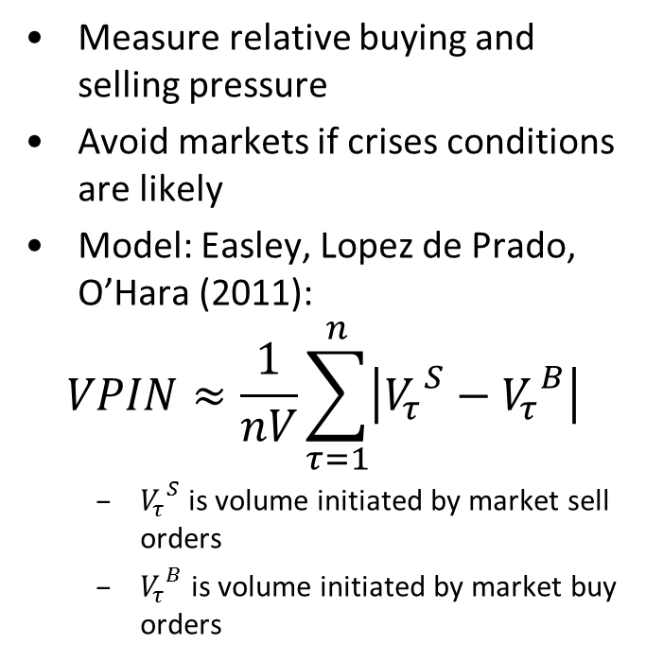
4. Detecting one-sided liquidity
Why this matters
What to do?
Too much buying or selling pressure may cause a run or a panic
Cross-asset models spread contagion
Market-wide destabilization ensues
=> Flash Crash
One-sided liquidity is “toxic”
Measure relative buying and selling pressure
Avoid markets if crises conditions are likely
Model: Easley, Lopez de Prado, O’Hara (2011):
$$VPIN≈\frac{1}{nV}\sum_{τ=1}^{n}{\left|{V_{τ}}^{S}−{V_{τ}}^{B}\right|}$$
${V_{τ}}^{S}$ is volume initiated by market sell orders
${V_{τ}}^{B}$ is volume initiated by market buy orders

Slide 44
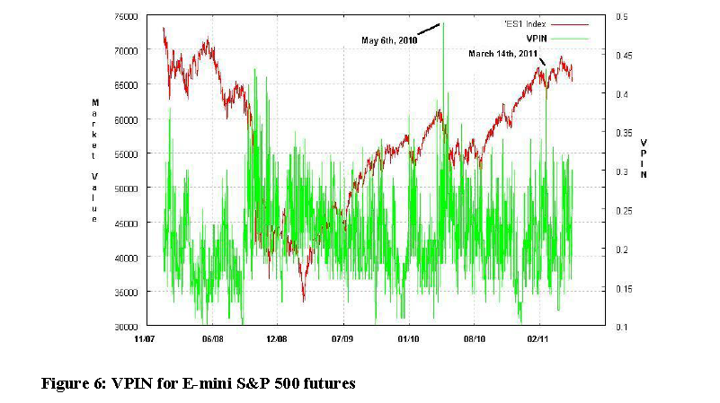
4. Detecting one-sided liquidity

Slide 45
Outline
Short-term forecasting
Modeling LOB Dynamics
Detecting market manipulation
Detecting one-sided liquidity
Detecting abnormalities in market data
Detecting impending market crashes

Slide 46
5. Are market conditions comparable to previous days?
If not, it can be a crisis
Testing
From fractal research
Normal markets evolve at random, yet steady pace
When the pace changes, perhaps a crisis is brewing
Check autocorrelations of
Price changes
Spread changes
…
across multiple securities
Separate random from non-random

Slide 47
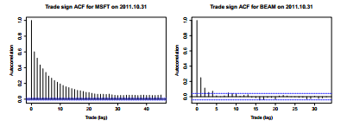
5. Market patterns
ACF of trade direction
Source: Bank of America Merrill Lynch

Slide 48
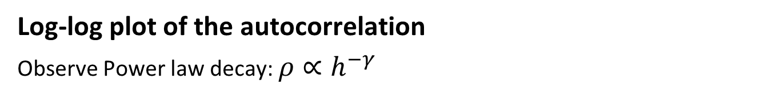
5. Trade autocorrelation
Log-log plot of the autocorrelation
Observe Power law decay: $ρ∝h^{−γ}$
High dependency = slow decay: $γ$=0.5
Low dependency = fast decay: $γ$=0.65

Slide 49
Outline
Short-term forecasting
Modeling LOB Dynamics
Detecting market manipulation
Detecting one-sided liquidity
Detecting abnormalities in market data
Detecting impending market crashes

Slide 50
6. Detecting market crashes
Market crashes = result of short-term market abnormalities
To detect an impending crash:
Measure toxicity (is it too high?)
Measure market data (is it consistent?)
Measure probability of market manipulation
Simulate extreme deviations

Slide 51
Outline
Short-term forecasting
Modeling LOB Dynamics
Detecting market manipulation
Detecting one-sided liquidity
Detecting abnormalities in market data
Detecting impending market crashes

